Slide 1
Are machine learning cloud APIs used correctly Reading summary
Presented by:
Kamma, Sriharibabu
Khan, Anas
Koduri, Sumana

Slide 2
Abstract
ML cloud APIs enable developer's easy solutions into software systems
Challenge
Not to use APIs correctly and efficiently for
Unique semantics
Data requirements
Accuracy-performance tradeoffs
No studies made on open-source application usage
Paper represents
Manual study on 360 open-source application indicate 70% misuse
The APIs issues in latest version are listed below
Degrade functional
Performance
Economical quality
To identify misuses:
Developed automatic checkers based on 8 Patterns
Kamma, Sriharibabu

Slide 3
I. Introduction
Motivation
API is making easy for non-experts to inserts the modules in software system
Challenges to be addressed are
Correct and efficient
challenges arise due to the nature of learning itself
Complicated data requirements
ML APIs uniquely defined by DNN training process
Complicated Cognitive semantics
The APIs are trained to perform the task
Semantics cannot be reduced to
Concise mathematical
Logical specifications
Complicated tradeoffs
ML APIs have additional trade off to consider
Accuracy
Software systems can suffer from inefficiencies, if accuracy is not addressed
Contributions
Misuses leads to reduced functionality
Degraded performance
Kamma, Sriharibabu

Slide 4
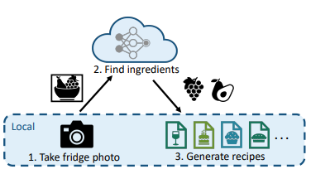
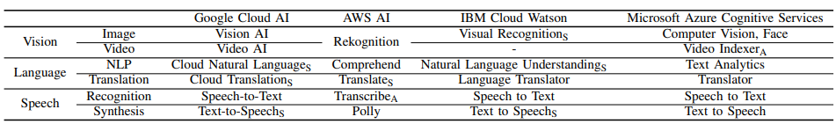
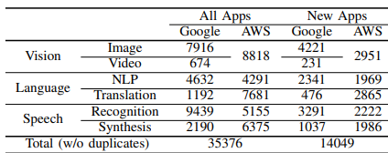
II. Background
The cloud servers covers three ML domains
Vision
Detecting objects, faces, landmarks, logos, texts from image or video
Language
Detecting or analyzing entity, sentiment, language from text
Speech
Text from audio input, audio from text input
Kamma, Sriharibabu

Slide 5
III. Methodology
Application selection
For automated checking all 12666 python applications on GitHub used
Covered different programming languages, python(86%), JS (13%), java (3%) and others (4%)
Checked 1200 applications to obtain the suite of 360 non-trivial applications
Anti-pattern identification methodology
Since there is no prior study on ML API misuses our misuse cannot rely on any existing list of anti-patterns
Designed test cases and ran applications to check misuse
To reduced functionality, degraded or increased cost comparing with another ML API which designed newly
Profiling methodology
Profiled the end-to-end latency for each related module and the whole process from users input to final output
They applications ran for five times for each input to reported the average latency
Kamma, Sriharibabu

Slide 6
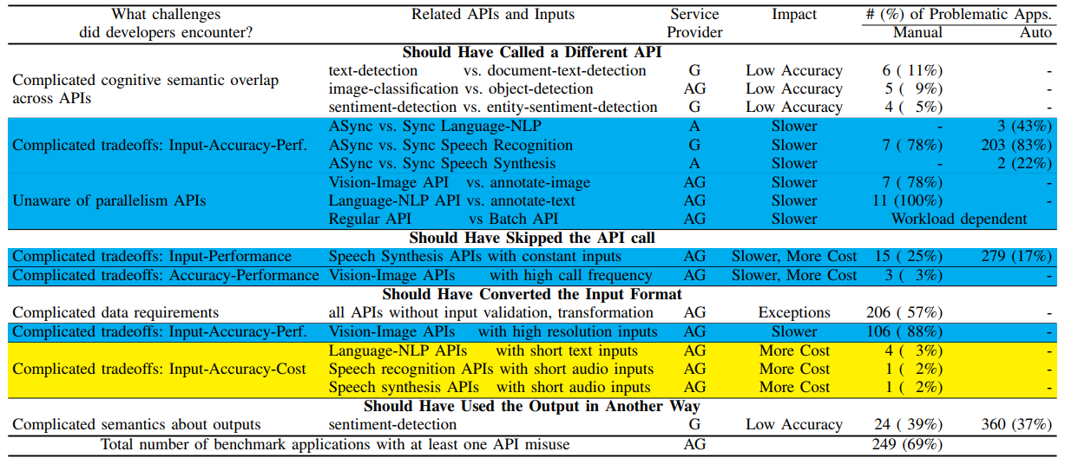
IV. Functionality related API misuses
Accuracy bugs due to API misuse in ML
Common in widely used API
Hard to debug
Program analysis, testing and DNN design help prevention
What API misuses lead to?
Affects the functional correctness of applications
Software misbehavior
Developers misunderstanding
Table: ML API misuses “A” stands for AWS and “G” for google
Khan, Anas

Slide 7
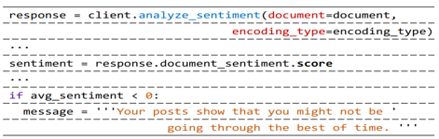
IV. Functionality related API misuses
Calling the wrong API examples
PDF-to-text
Uses text-detection to process document scans
Whats-in-your-fridge
Tell a user what products are currently inside the fridge
Phoenix
Detect fire in photos and warn users
Misinterpreting outputs
Journal Bot
API to judge emotion in a user
Missing input validation
Automatic-door
Take Input camera images
Decides to open or close a door using face
Fig: Misinterpreting outputs in JournalBot
Khan, Anas

Slide 8
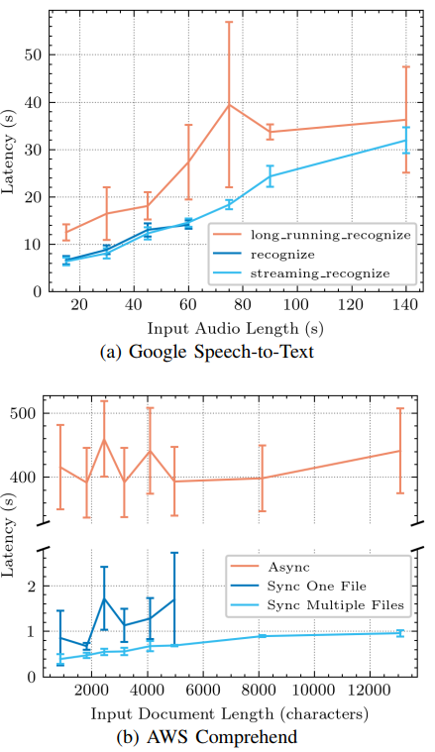
IV. Functionality related API misuses(cond..)
V. Performance related API misuses
Challenges and Solutions in DNN Models to detect APIs
Sentiment detection API from Google NLP
39% of 62 applications using the API misinterpreted results
Static program analysis to detect misuses of ML API results to alleviate these problems
Khan, Anas

Slide 9
V. Performance related API misuses
Performance anti-patterns
Time taken to process data
Delaying affects user experience
Inefficient use of ML APIs is must
Misuse of Asynchronous API
Poor performance
Tradeoff between accuracy and stability
Synchronous & Asynchronous ML API
Asynchronous ML APIs allows longer audio/text input
Jiang-Jung-Dian is an application that automatically generates meeting reports
Replacing with streaming call
Streaming API directly upload to audio file and confusion among developer synchronous
Example : Potty-Pot
Detects offensive language in audio streamed from a microphone
Class-scribe LE
Records lecture audio and then calls the asynchronous API to generate lecture notes
Khan, Anas

Slide 10
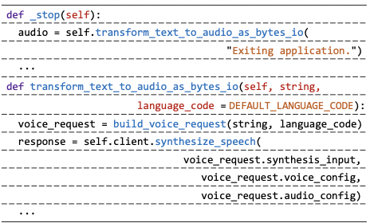
V. Performance related API misuses
Forgetting parallel APIs
Forgetting task parallelism
Forgetting data parallelism
Email Classifier
Samaritan
Summary
Making skippable API calls
API calls with constant inputs.
60 benchmark applications use speech API
Sounds-Of-Runeterra
Existing applications replace with audio clips
API calls with excessive frequency
Ns-Tool
Tags
Fig: Skippable call@sounds-of-runeterra
Koduri, Sumana

Slide 11
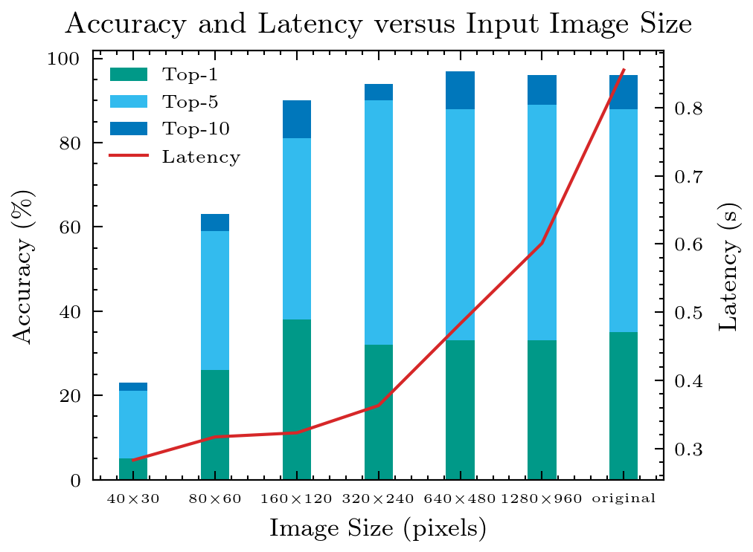
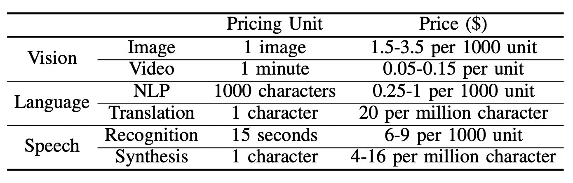
V. Performance-related API misuses
VI. Cost related API misuses
Unnecessarily high-resolution inputs
Fig: Accuracy and latency with different input resolutions
ML API multiple calls with single inputs create problems
Audio-sentence-split
ML charging policy creates trade-off space
Table: Cost of google cloud AI services
Koduri, Sumana

Slide 12
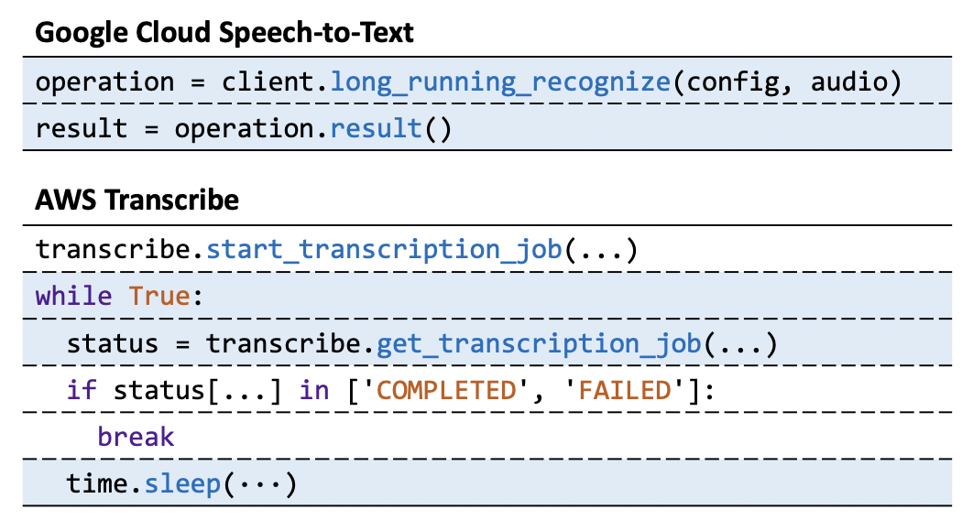
VII. Solutions
VIII. Threats to validity
Output Misinterpretation checker
Asynchronous API call checker
Constant-parameter API call checker
API wrappers
Fig: Using asynchronous API in synchronously
Internal threats to validity
Inputs used in inference-accuracy may not represent the exact workload
External threats to validity
Study ML API by google and AWS but not service providers
Cloud APIs with pre-trained DNNs designed for general purpose
Open- source projects on GitHub
Koduri, Sumana

Slide 13
IX. Related work
X. Conclusion
Applications design their own DNNs
Design and implementation of machine learning APIs
Focuses on server side instead of client side
Designing and improving Faas platforms
Understand challenges using machine learning APIs
Latest version of 360 open-source using google and AWS ML cloud
8 types of common API misuses that cause functionality, service, performance
Static checker to automatically detect problems
Koduri, Sumana

